Slide 1
FDIBCP summary

Slide 2
Behaviour analysis
SSVEP analysis
CPP analysis
LRP analysis
MB analysis
EMG analysis

Slide 3
accuracy Summary
no clear difference in acc between FDI and BCP 82%
Easy (0.14) has higher ACC 89% vs 80%
no clear difference in acc between left and right hand 82%
RT Summary
correct RT is faster than Wrong RT
BCP is 20-30ms faster than FDI only in correct trials
Low(Hard) slower RT , more symmetric, High(Easy) more left screw;
left is around 80ms (45 correct 120 for wrong) slower than right response (all right hand user)

Slide 4
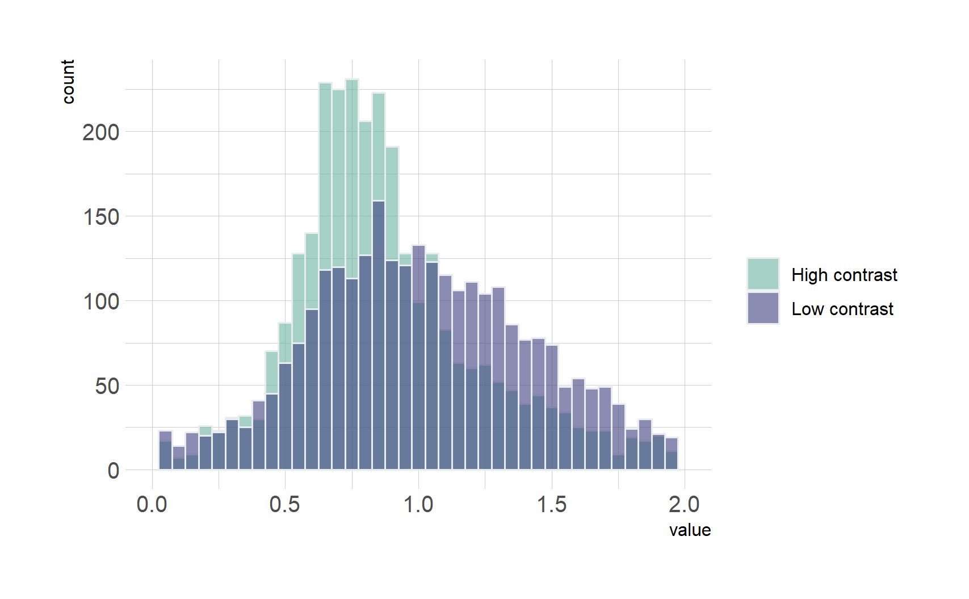
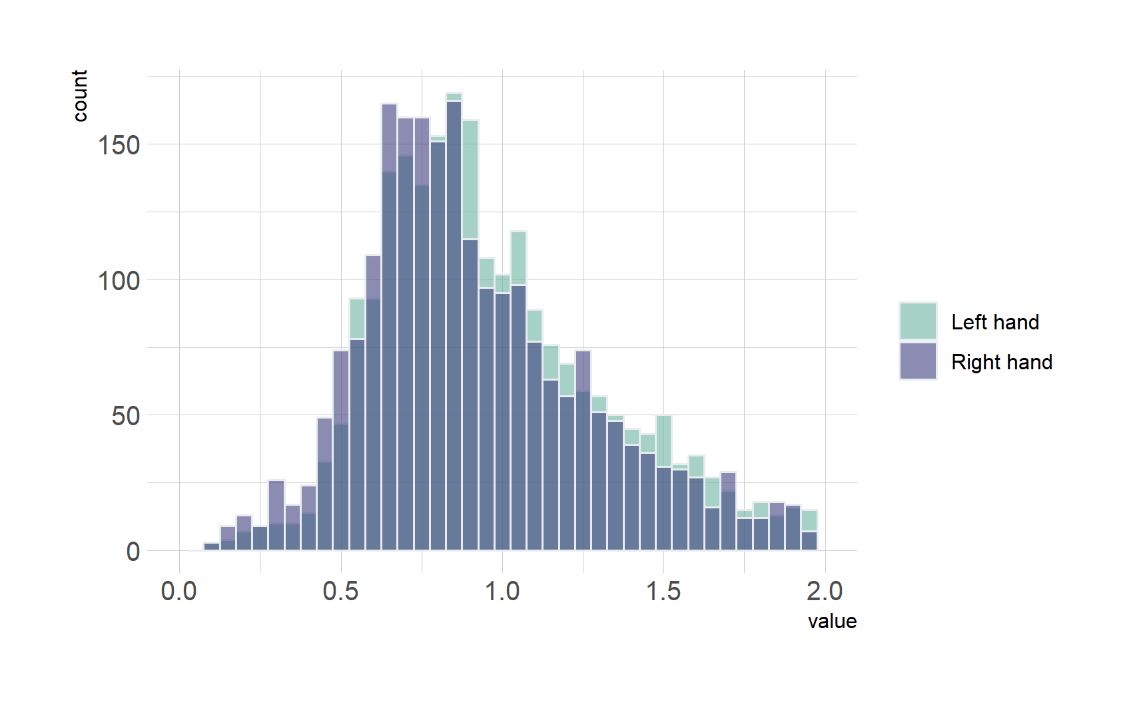
Welch Two Sample t-test data: E_RT_C and H_RT_C t = -12.565, df = 4088.8, p-value < 2.2e-16 alternative hypothesis: true difference in means is not equal to 0 95 percent confidence interval: -0.1541506 -0.1125373 sample estimates: mean of x mean of y 0.8868534 1.0201973
Low(Hard) slower RT , more symmetric, High(Easy) more right screw;
Welch Two Sample t-test data: L_RT and R_RT t = 7.5233, df = 5831.7, p-value = 6.149e-14 alternative hypothesis: true difference in means is not equal to 0 95 percent confidence interval: 0.05844823 0.09964206 sample estimates: mean of x mean of y 0.9717512 0.8927061
Left is around 80ms slower than right (all right hand user)

Slide 5
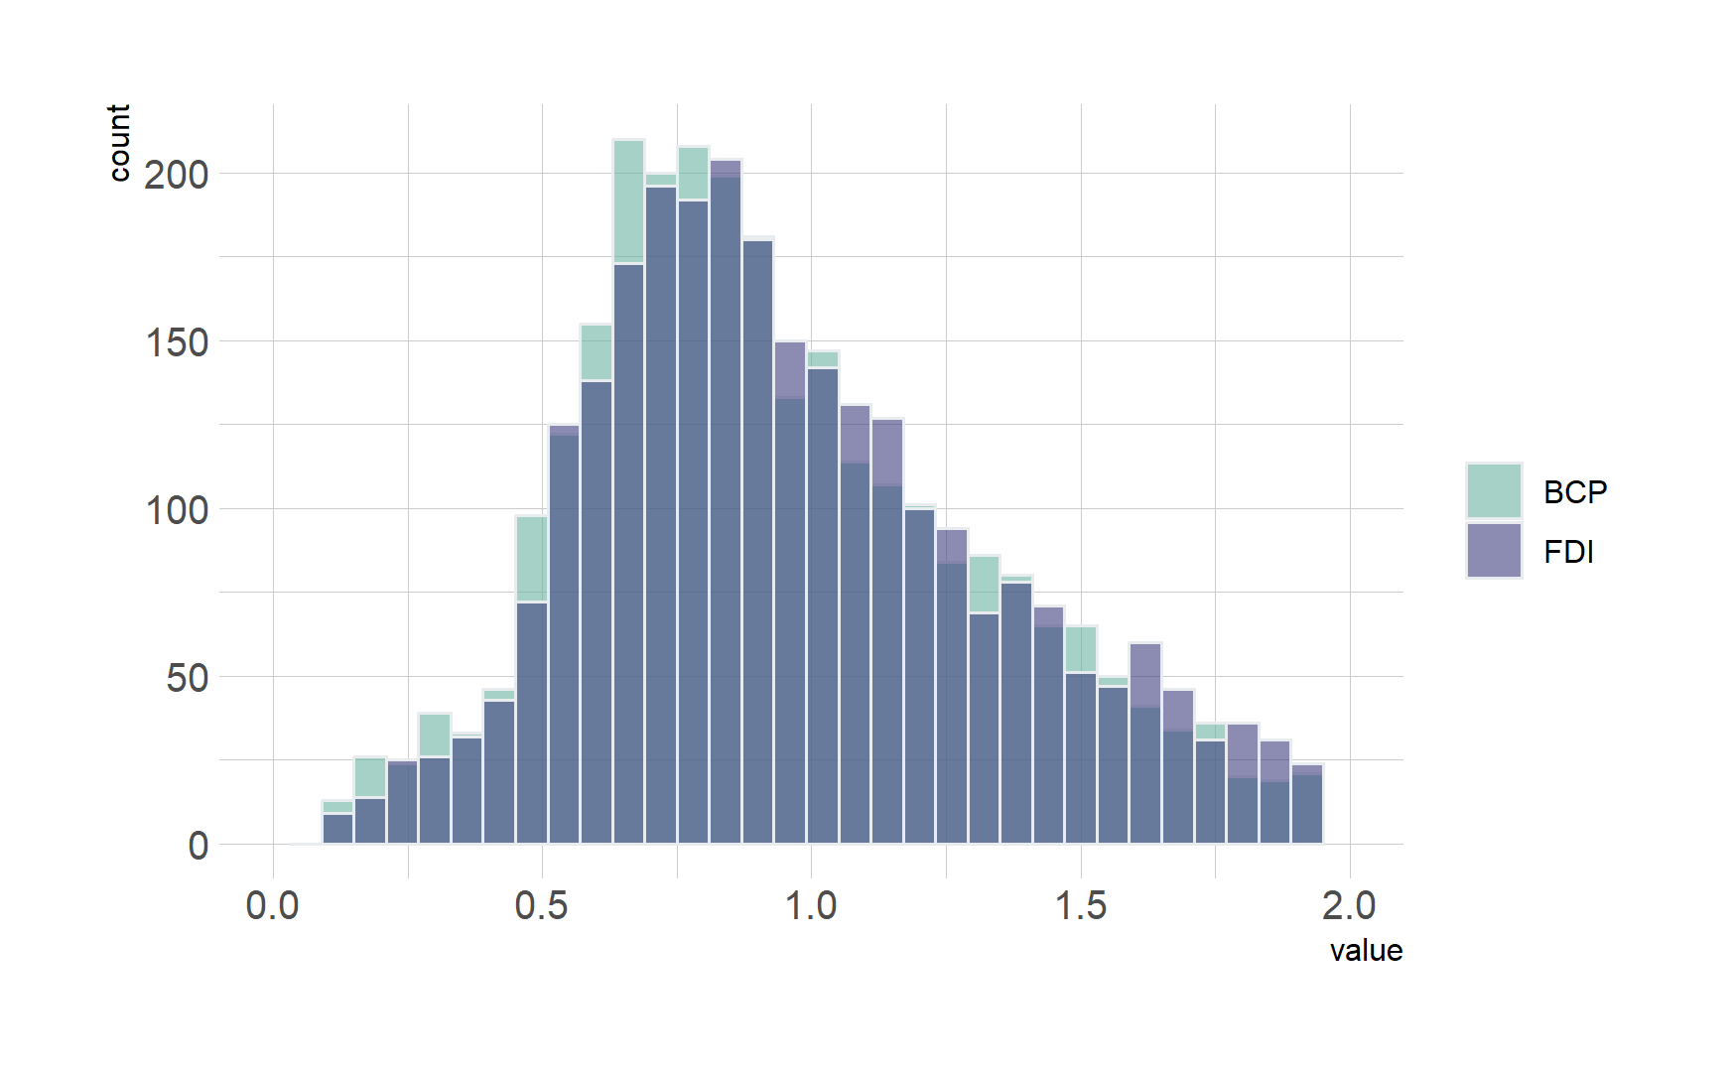
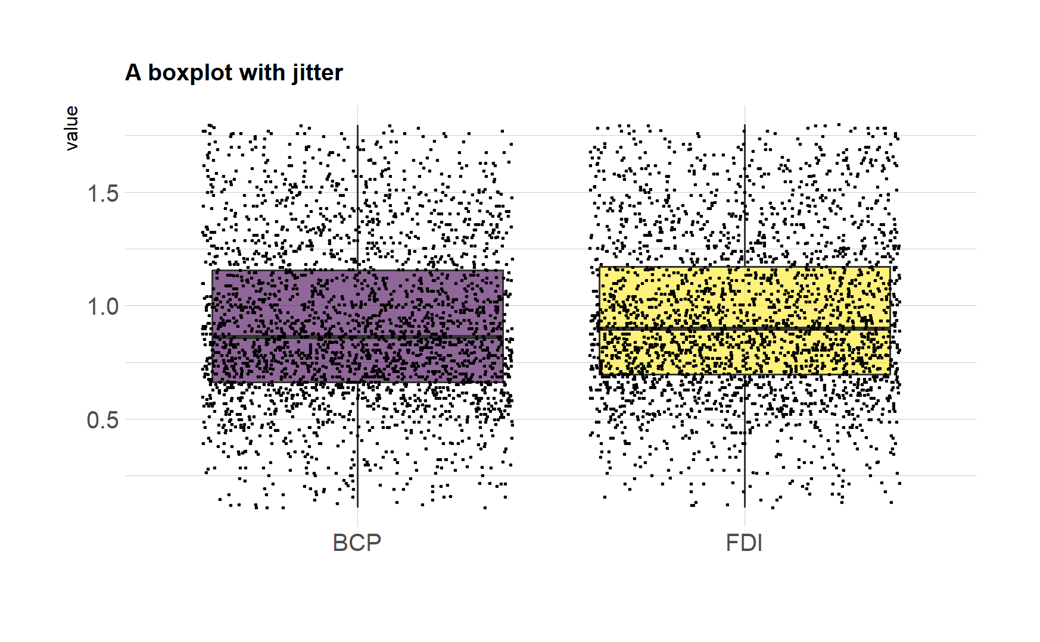
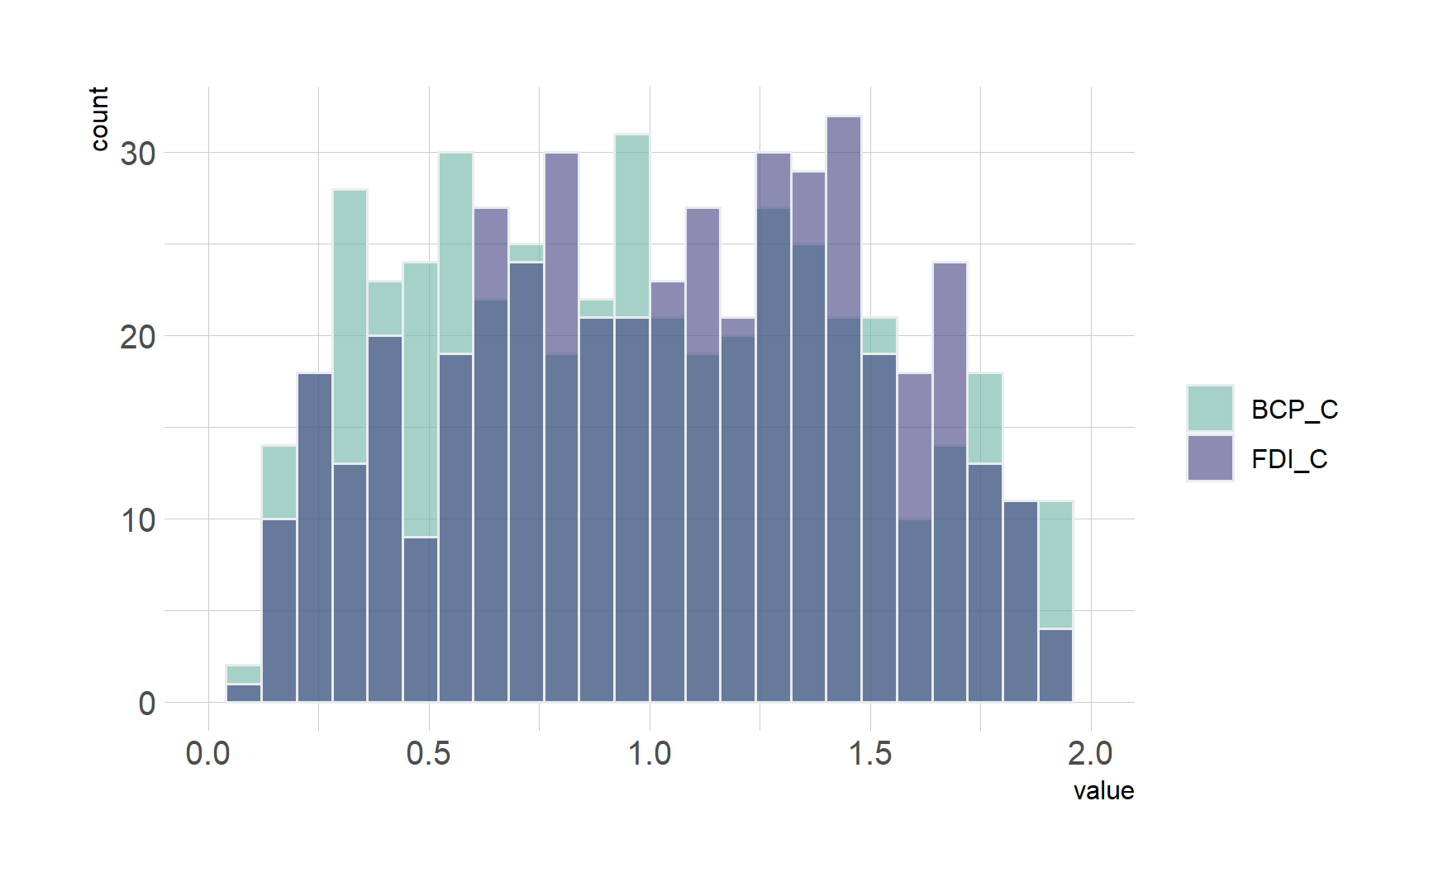
Welch Two Sample t-test data: FDI_RT and BCP_RT t = 2.6998, df = 5343.1, p-value = 0.00696 alternative hypothesis: true difference in means is not equal to 0 95 percent confidence interval: 0.007129105 0.044932677 sample estimates: mean of x mean of y 0.9428334 0.9168025
BCP is 20-30ms faster than FDI in correct and wrong trials

Slide 6
SSVEP

Slide 7
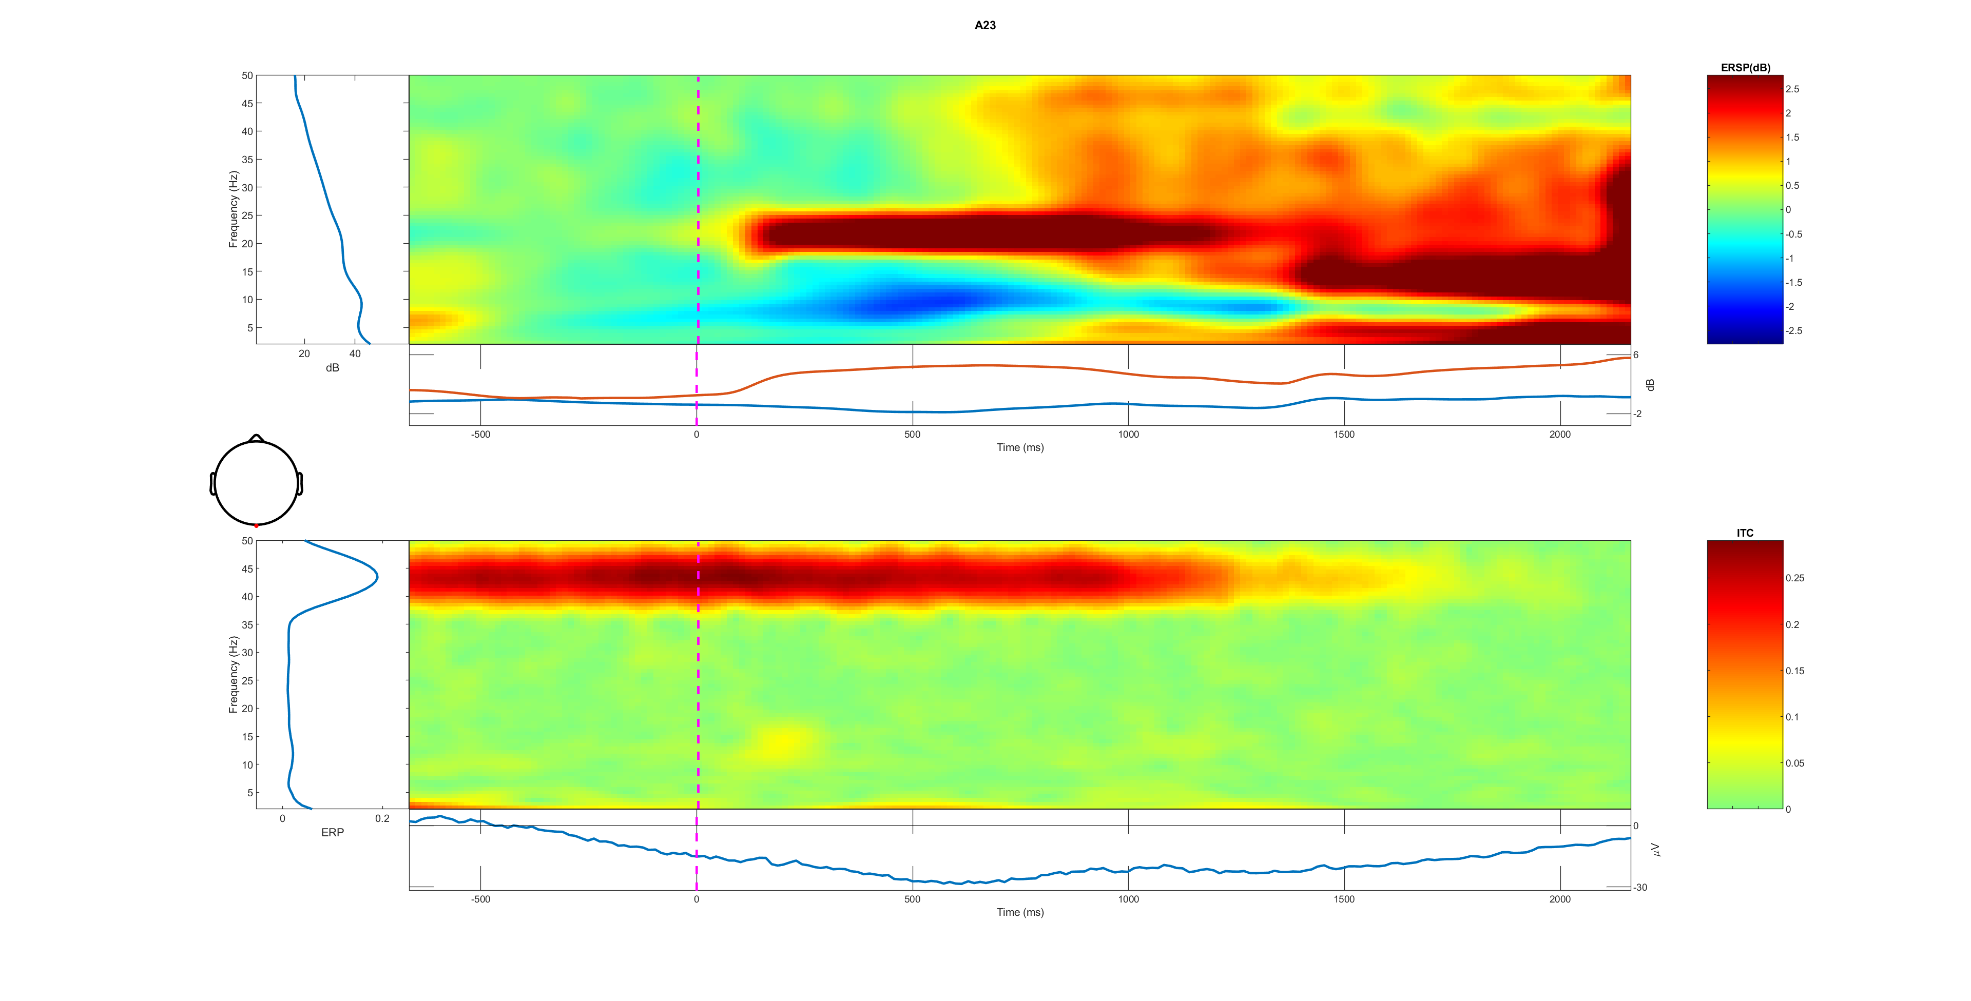
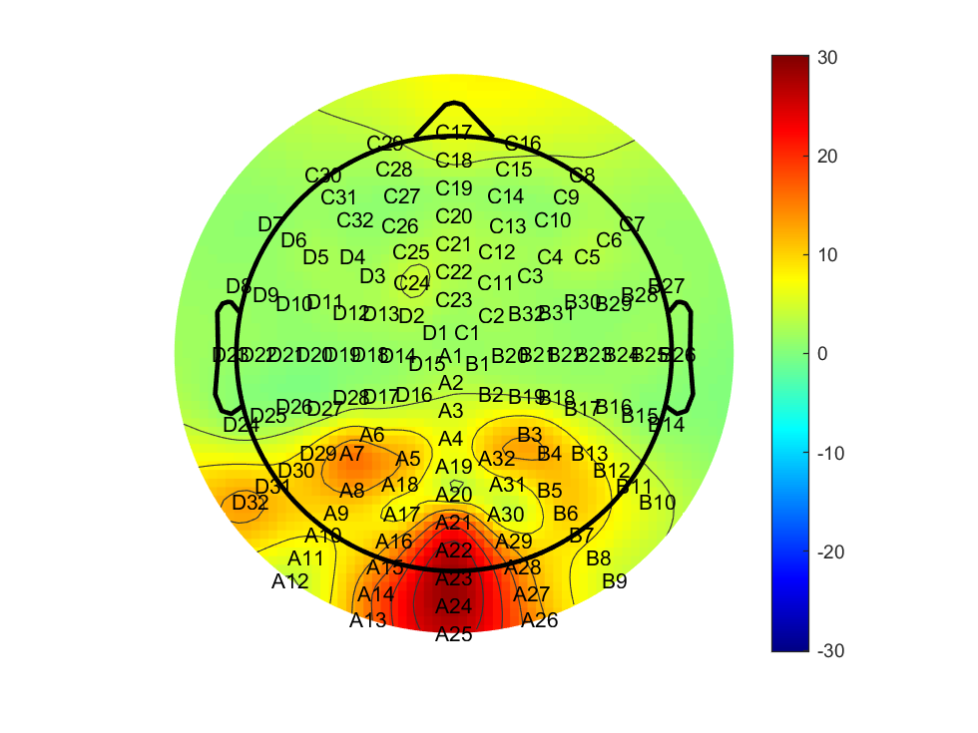

A23 all trail 0-50Hz

Slide 8
Low-1 vs high-2 (correct vs wrong)

Slide 9

BCP (2) slightly higher at first but lower slop, lasting longer FDI higher in the steady stage initial stage different?

Slide 10
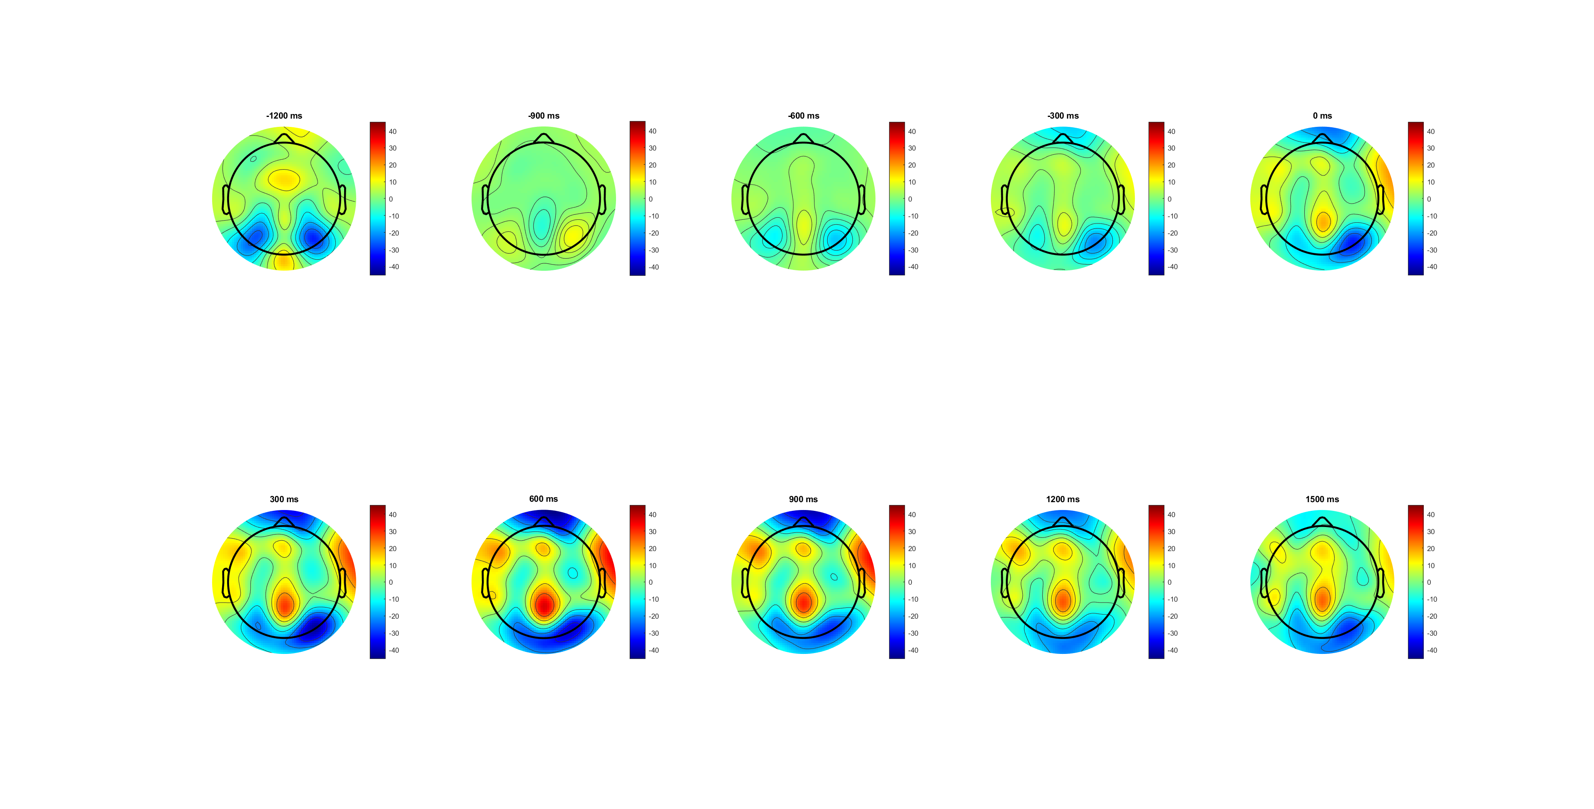
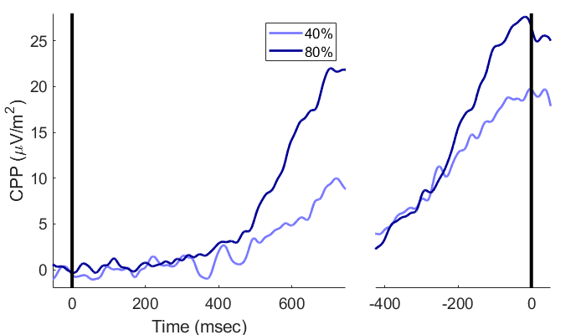
CPP

Slide 11







Slide 13
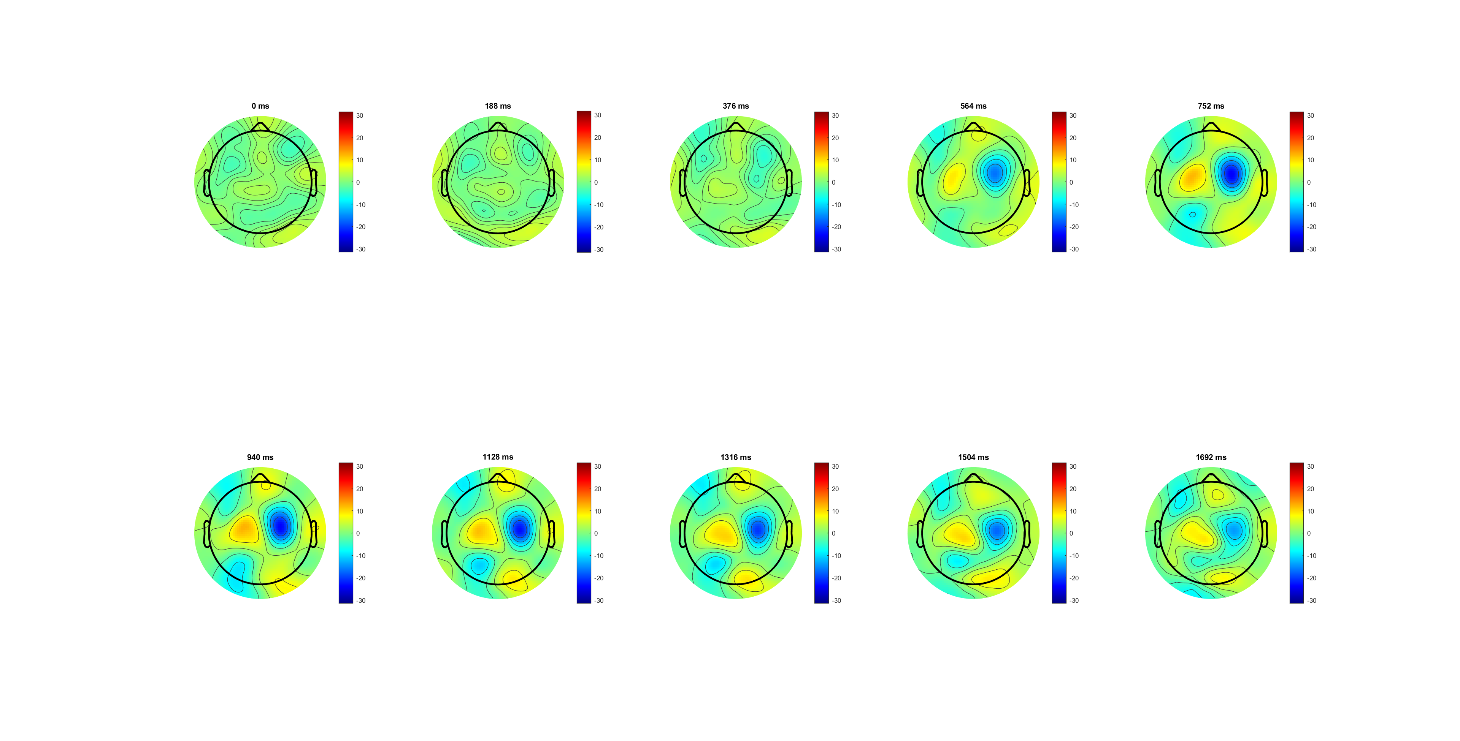
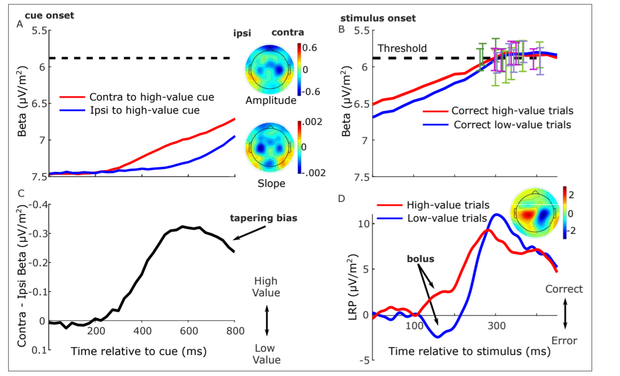
LRP analysis

Slide 14
After evidence on (300ms) shows the diff.
Correct steeper slope
Correct higher amplitude in the end
high 0.14 have higher amplitude
high 0.14 have steeper slope in both increasing and decreasing period

Slide 15
BCP higher amplitude in SL
Same slop
FDI higher amplitude in RL

Slide 16
MB analysis
Wrong and low 0.07 have higher MB amplitude
BCP higher MB amplitude
Location: FDI wider and middle; BCP narrower and frontal

Slide 17
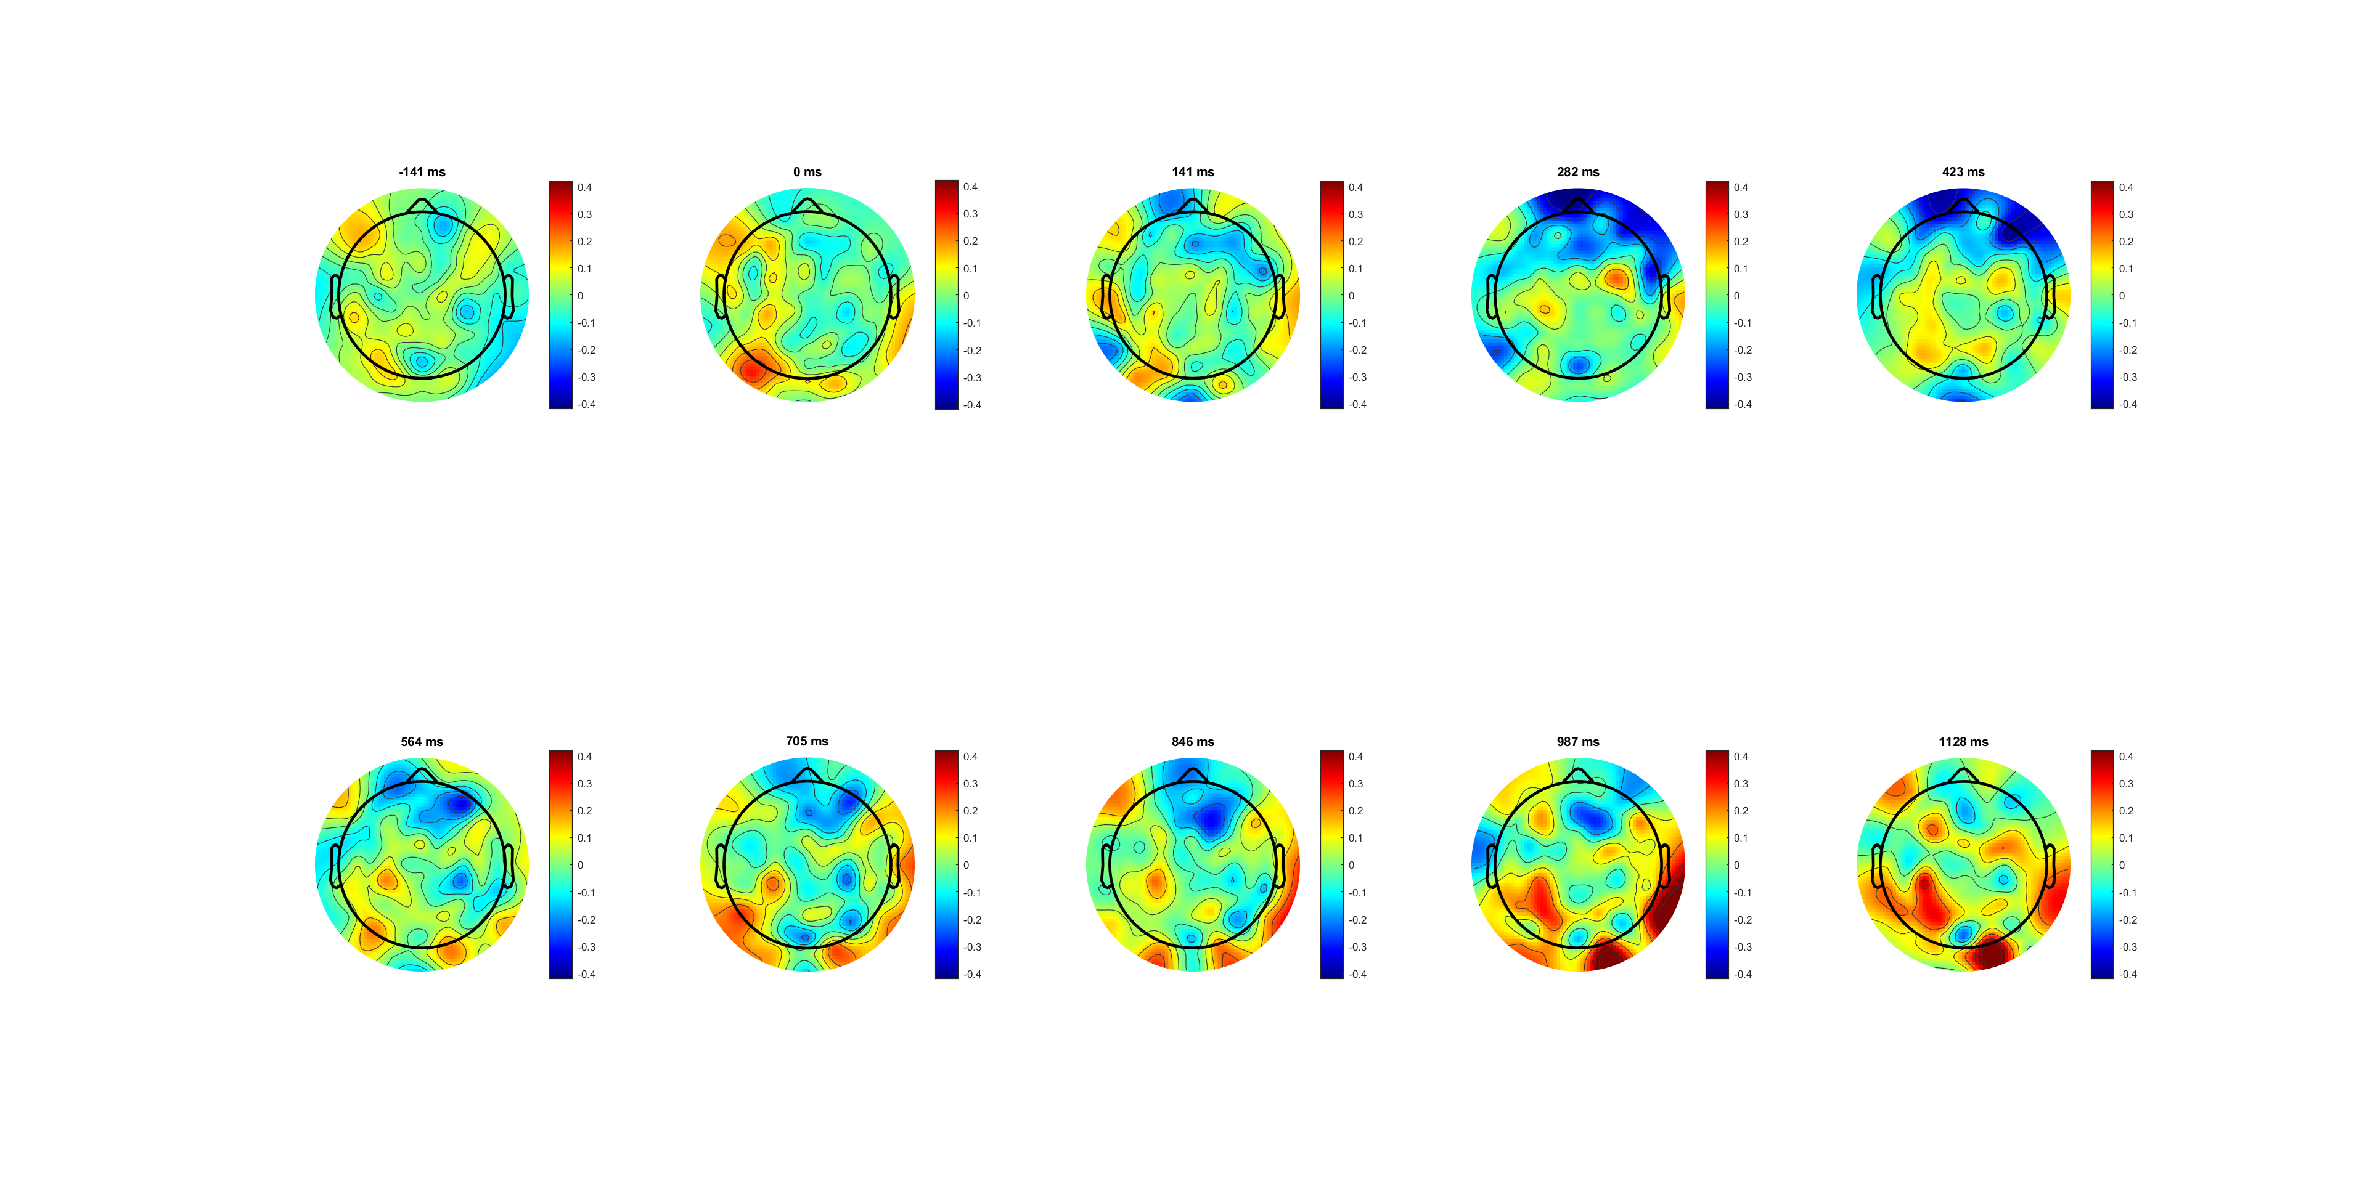


Correct lateralisation (L-R) 0.4limit

Slide 18
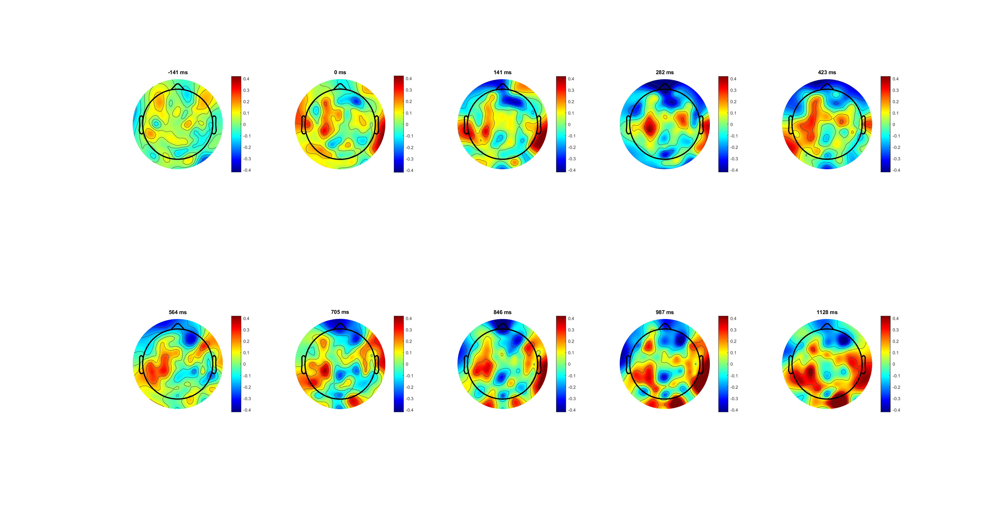



Slide 19
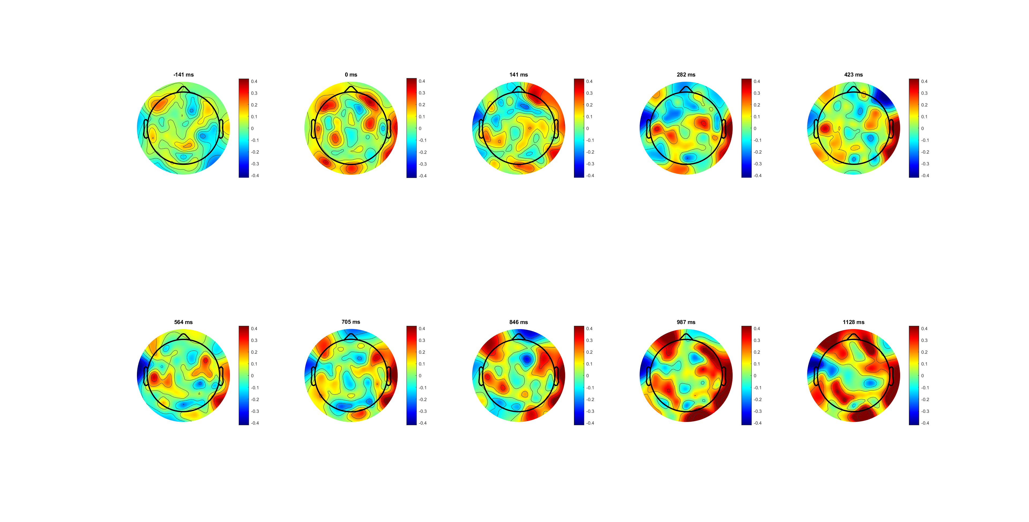
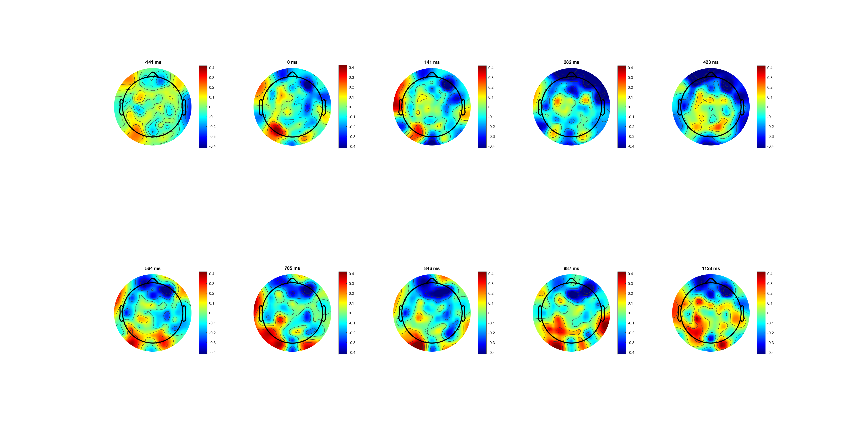



FDI
Because different location
Can’t compare between FDI and BCP using same channel,(better way?)
BCP

Slide 20
FDI (C3/4+) BCP (C3/4+)
The lateralization (left- right) of BCP is more obvious than that of FDI
*muscle amount diff/ control diff

Slide 21
116 55
BCP is in mu /low beta band is higher, and FDI is higher in high beta band

Slide 22


EMG analysis
No low partial EMG bursts in biceps(change of minds)
Lots partial EMG bursts in FDI
BCP bursts faster (lower motor time-MT)
Notes:
4. Less motor execution time for biceps 更快top-down loop and less feedback
5. decision time decrease partially (more simply connection, less sensorimotor integration/feedback loop )
6.for continuous flow, EEG should more related to sensory evidence, and EMG should more related to behaviour results
Distal more complex, more decision process /information processed during the flow
7. From continues flow, boundary may different
边界positive effect， 滚雪球；自我加大，
Read urggency+ Cisek 的paper urgency gating model adding to acc+grows over time+***evency +Leak signal
和 bound一样。 Later is more important
cortious
动态的可以突然加减
不可以取消
Read triger
心理学内核

Slide 23
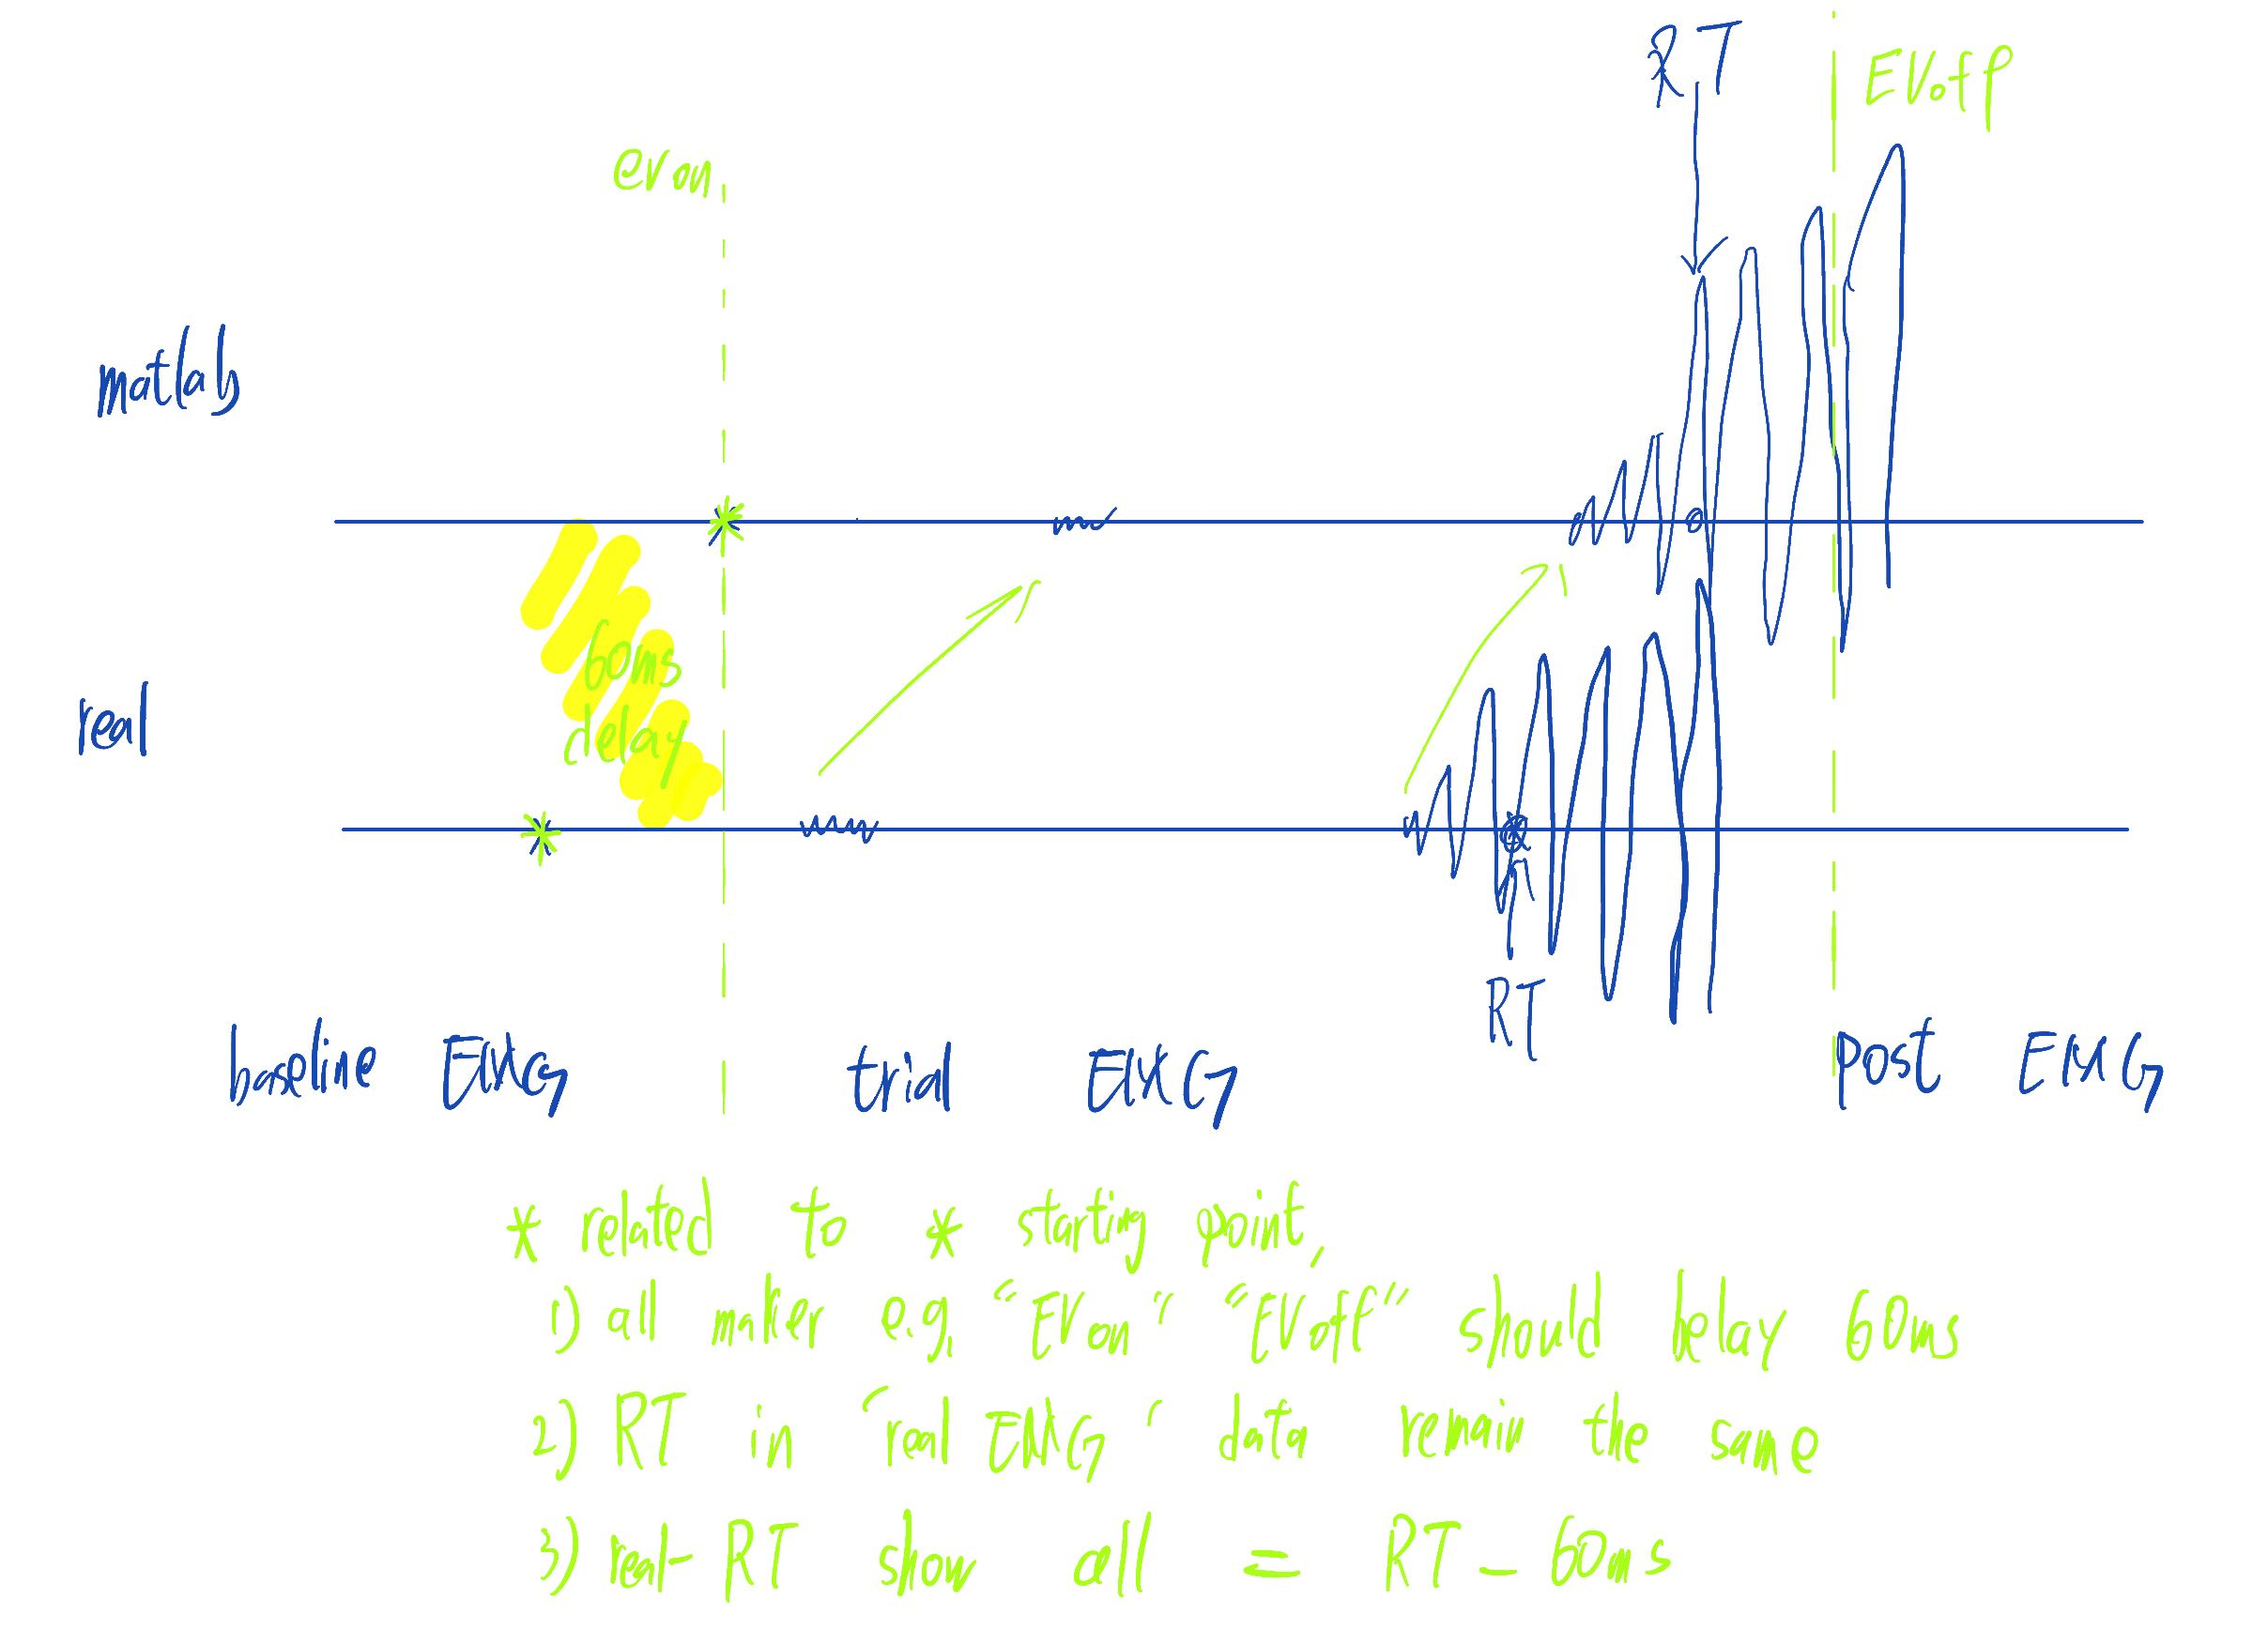
Delay elimination (60-70ms)

Slide 24










Slide 25
The quality of left and right signals and signals from different muscles is different
Right is good
Only analysis right for polit
Findings:
FDI longer motor time (around 100ms)
FDI more partial bursts
BCP almost no partial bursts and peaks faster (around 80ms)
2068 -> sum((movement_counts_right==1 | movement_counts_right==2))
-> sum(movement_counts_left==1 | movement_counts_left==2| movement_counts_left==3)
2583 -> sum(movement_counts_right==0)
4867 -> sum(movement_counts_left==0)

